Slide 1
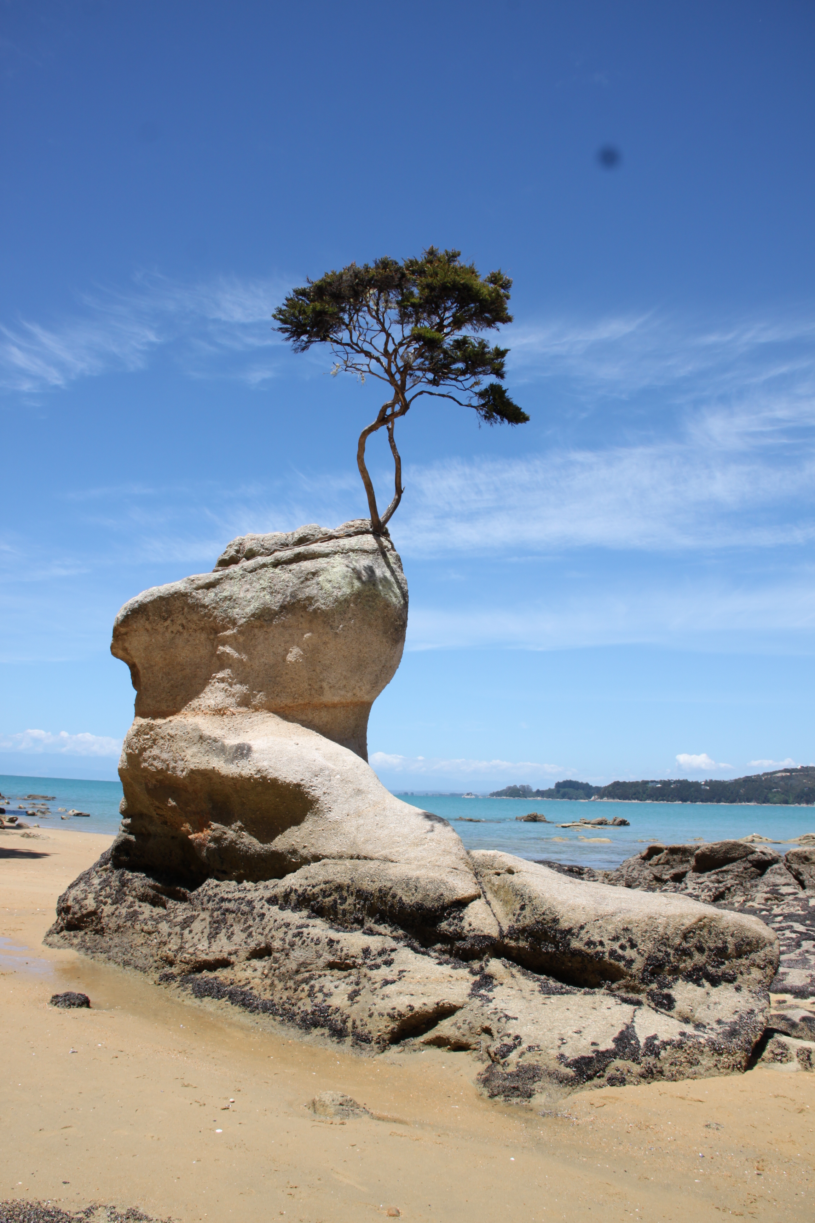


The tipping point
How can we help young people in Aotearoa New Zealand to flourish, in an uncertain world?
Christina Curley
Upwards and Savvy Up
S. Andrews on the Terrace
6 April 2017

Slide 2
What I’ll cover
Cultural myths
Systems
Us

Slide 3
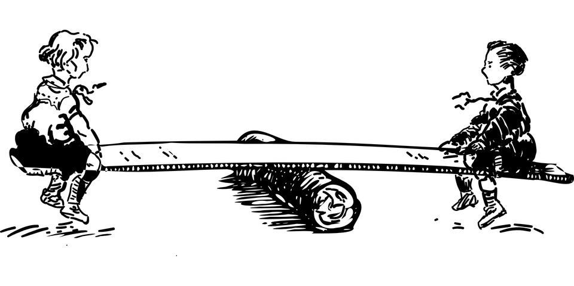
Separation and connection

Slide 4

From the macro level

Slide 5
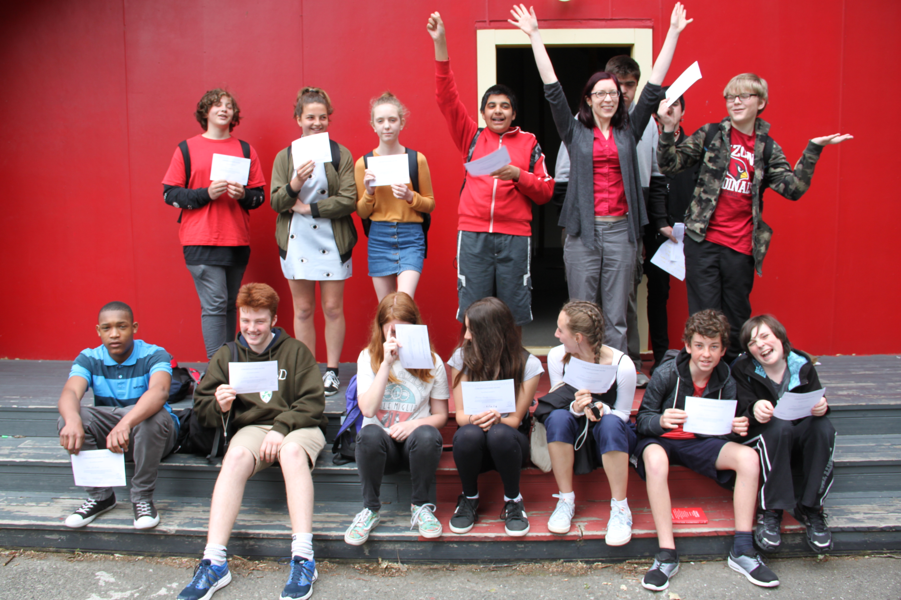
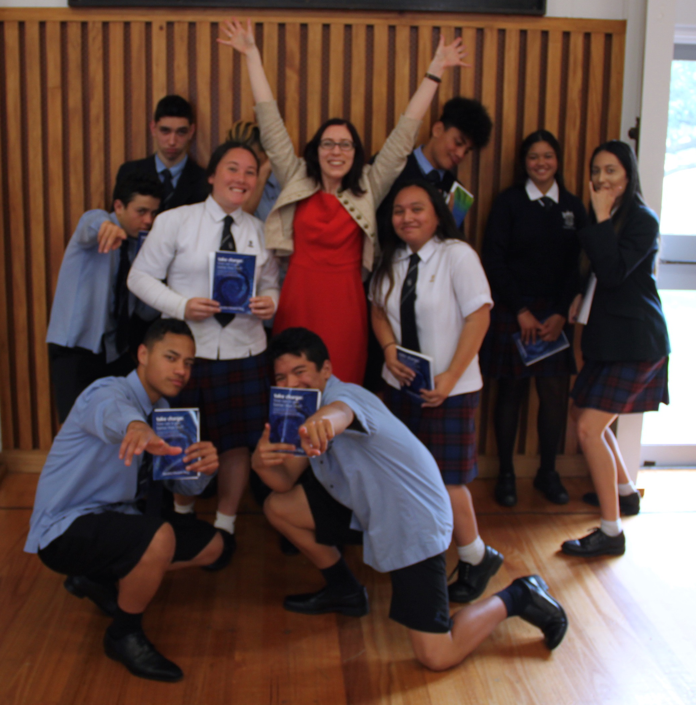
To the micro

Slide 6


Thank you!
Savvyup.co.nz
Upwards.co.nz

